Slide 1
SharePoint Add-Ins
Introduction

Slide 3
How to View This Presentation
To switch to Notes Page view:
On the ribbon, click the View tab, and then click Notes Page
To navigate through notes, use the Page Up and Page Down keys
Zoom in or zoom out, if required
In the Notes Page view, you can:
Read any supporting text—now or after the delivery
Add notes to your copy of the presentation, if required
Take the presentation files home with you

Slide 4
Overview
Add-In Model Fundamentals
In this Lesson
Choosing an Add-In Model
Considerations

Slide 5
Objectives
Understand the SharePoint Add-In Architecture/Concept
Learn how to decide between different Add-In Models

Slide 6
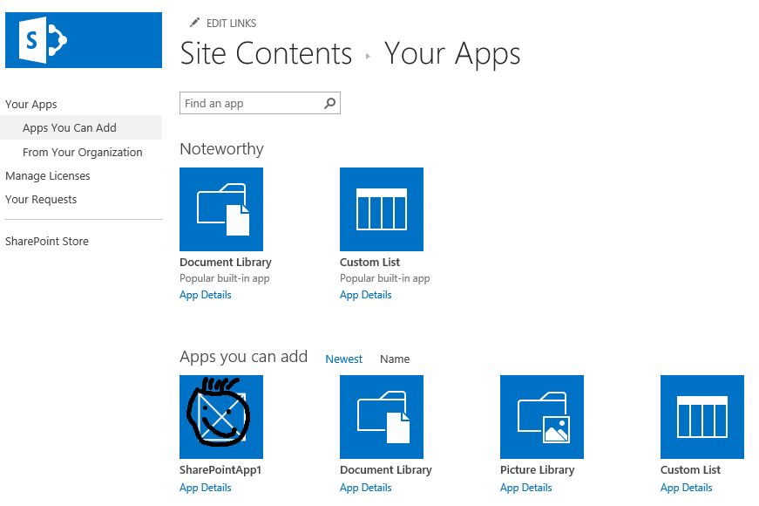
What are Add-Ins?
Apps introduced in 2013
Aka Add-Ins
Reduce complexity for end users
Self-contained
Extends SharePoint website capabilities
Notes:
In previous versions there were many terminologies in use to define i.e. document libraries, picture libraries, etc. For the average end user, these words didn’t mean much. And that should be fine. They just want to get their stuff done. In SharePoint 2016 many components are now grouped under the generic name Add-Ins. So whether you want to add a new document library, photo album or want to add another instance of your custom functionality, you’ll be adding an Add-In.

Slide 7
Why Add-Ins?
Root cause of most SharePoint outages and issues caused by custom code
Get in line with modern technology instead of staying one step behind
Improved scalability
Enable the cloud
Remove limitations set up by the platform
Allow developers to each their favorite technologies, whichever they are
Notes:
Historical data from Microsoft Support has shown that most outages and issues on SharePoint farms were caused by custom code being deployed to the platform. Introducing Sandboxed Solutions in SharePoint 2010 was an attempt to set boundaries for developers to make customizations more secure and avoid noticeable impact on core SharePoint functionality by customizations.
Customizations for SharePoint tended to use to always be one step behind on modern day technology. I.e. the .NET Framework used was always one step behind on the latest and greatest out there. By moving to Add-Ins, it opens up the doors to use the latest technology right when it becomes available, without having constraints with the SharePoint platform.
Ease the scalability of your customizations. No longer do you need to add a whole SharePoint frontend to add extra capacity to your SharePoint farm just to handle your customizations. You can add extra capacity where you need it most.
Allow for cloud use. Both in the sense of running SharePoint as well as running your customizations.
Remove limitations set up by the platform. You’re not tied to using C#, you’re not even tied to using Microsoft technology for creating your customizations.
Like using ASP.NET MVC? Add bootstrap to it? Use Modernizr to get rid of worries about older browsers? No problem, go ahead because now you can.

Slide 8
Add-Ins in short
SharePoint Add-Ins no longer live in SharePoint
Custom code executes in the client, cloud or on-premises
Add-Ins are granted permissions to SharePoint via OAuth
Add-Ins communicate with SharePoint via REST, CSOM or JSOM
Acquire Add-Ins via centralized SharePoint Store
App Catalog
SharePoint Store
APIs for manual deployment
Notes:
The new SharePoint Add-In model is designed to not only address issues around the solution package approach to SharePoint customization, but also to introduce new capabilities. SharePoint Add-Ins do not live in SharePoint, rather they execute in the browser client or on a non-SharePoint server such as an IIS server or in the cloud. Add-Ins are granted permission into SharePoint sites via OAuth and communicate over the new investments in the REST and CSOM APIs.
Developers will be able to publish their Add-Ins to a public marketplace for download & purchases. In addition organizations will be able to create a private corporate marketplace (App Catalog) where the Add-Ins would be available to the organization.

Slide 9
When to use Add-Ins?
Scenario focused, examples include:
Time off request Add-In
Time off request approval Add-In
Team time off overview calendar Add-In
Confined functionality, don’t create and leave clutter
Site Owners are in control
Remove challenging SharePoint upgrades
Works both on-premises as well as in SharePoint Online
Address a bigger group of developers, specific SharePoint knowledge is no longer required
Notes:
Think small when it comes to Add-Ins. Create an Add-In for a confined piece of functionality only. Rather create multiple Add-Ins to separate functionality as the sample on this slide shows. This eases the development and maintenance and improves security. Make the time off request Add-In available to all of your users, but limit the availability of the time off request Add-In to managers only. Add the team time off overview Add-In by default to all team sites created in your organization. It all becomes possible if you think small.
No longer will customizations pollute the SharePoint content database leaving stuff behind. When an Add-In installs, it is its responsibility to add everything it needs. When it gets removed, SharePoint will automatically clean up after itself by removing the components belonging to the Add-In instance.
Site Owners are now in control. No need to get SharePoint farm administrators involved anymore each time you want to deploy a Full Trust Code solution. Leave it up to your end users to decide whether or not certain functionality will be of use to them while keeping the ability to centrally provide updates and fixes for customizations made available in your organization.
The benefits of going with SharePoint Add-Ins are numerous. This slide mentions some of them. One huge advantage is removing the challenging upgrades to future SharePoint versions. Cloud is the future. Whether it is suitable for your environment now already or potentially in the future, you will be ready for it when the time comes.
Good SharePoint Developers can be hard to find. Using Add-Ins you extend your reach to pretty much any developer making it easier to find the people you need to get your customizations built.
All of this, while still keeping all options for hosting open. Whether it will remain on premises, in the cloud or a combination of the two (hybrid), it’s up to you.

Slide 10
Add-In Hosting Options
Provider Hosted
Hosted using any technology on any platform (incl. Azure)
Recommended approach
SharePoint
Add-In Hosted Outside of SharePoint
SharePoint Hosted Provision an isolated subsite (SPWeb) under the host web
Reuse web elements (lists, files, out-of-box web parts)
No server code allowed; use client JavaScript for logic
SharePoint
Add-In Hosted in SharePoint
Notes:
For the hosting of Apps you can choose from two models: Provider Hosted and SharePoint Hosted. When choosing provider hosted, it means that your Add-In will be hosted somewhere outside of SharePoint. This can for example be on Azure Websites, an IIS Farm within your enterprise, on some Apache server or anywhere else using any technology you would like. This method is the recommended approach since it offers full flexibility of technology to be used including the use of server side code.
The other option, SharePoint Hosted, offers you the ability to host your Add-In inside of SharePoint. Since we stated before that no custom code is allowed anymore within SharePoint, this means that when choosing this option, you can only use JavaScript to execute functionality within the user’s browser. No server side logic or code can be executed in this model. The big advantage that this hosting model has is that it is easy to configure and doesn’t require you to set up and maintain a separate web farm.
During the remain of the training it should become more clear when to use which of these hosting options.

Slide 11
Add-In Hosting Options
Host Web
App
Web
Add-In
Host Web
Subsite (SPWeb) on which the Add-In is installed in SharePoint 2016
App Web
Hidden subsite (SPWeb) created for one Add-In instance
Uses a technique similar to host named site collections
Visible via PowerShell
Only created when at least one artifact exists in the Add-In project
Add-In
The actual logic which the Add-In offers
Hosting and location depends on hosting option
Notes:
A single SharePoint Add-In can consist out of several components. The Host Web is the site in SharePoint where you choose to install an Add-In. The AppWeb is created for a single instance of your Add-In. If you install the same Add-In twice, each on different sites, it will create two different AppWebs. Not always will there be an AppWeb. If you create a Provider Hosted Add-In and add no elements to the Add-In project in Visual Studio, SharePoint will not create an AppWeb for the Add-In. This doesn’t have to be a problem, but be aware that this is the case.
The last component is the Add-In itself. Depending on the hosting option chosen (SharePoint Hosted or Provider Hosted), this lives in its own subsite within SharePoint or lives completely outside of SharePoint.

Slide 12
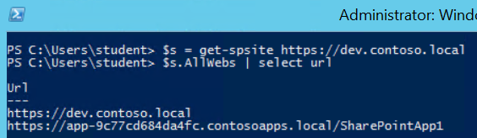
Add-In Hosting Options
When Add-Ins are provisioned, a new SPWeb (AppWeb) is created within hosting SPWeb
Each Add-In instance resides within its own SPWeb for isolation
Special DNS address configured by administrators in which Add-Ins live
Each Add-In hosted on its own unique URL
Blocks XSS: isolation to special SPWeb under special domain blocks cross site scripting
Enforces Add-In Permissions: Add-Ins communicate with sites via CSOM / API and must be granted access to do so
Notes:
When an Add-In is installed, SharePoint creates a special SharePoint site (SPWeb) for the Add-In. This site, called an AppWeb, is given it’s own top-level URL that is different from the hosting site. This unique URL enforces two things:
Blocking cross site scripting (XSS) – because the hosting site & the AppWeb are in different domains, browsers will block any script that tries to access resources in different domains.
Enforcing Add-In Permissions – Add-Ins will only be allowed to access SharePoint sites if they have been granted access to do so and when they do, they can access it using the CSOM or OData APIs.
Using PowerShell you can see “behind the scenes” where an AppWeb lives: as a subsite of the site on which the Add-In was installed.

Slide 13

Add-In Hosting Options
Understanding the AppWeb URL
Scenario: Add-In installed in https://intranet.contoso.local/sites/team/subsite
App Web URL would look like
Dissecting the App Web URL
https://tenant-appuid.appdomain.com/sites/team/subsite/appname
https://app-bf473b52250f.contosoapps.local/sites/team/subsite/AppName
Tenant
Configurable for an on-premises installation (one name for your whole farm)
Based on your tenant name on SharePoint Online
AppUid
Unique ID given to each Add-In installation in tenancy
Makes each Add-In domain unique
Consists of random characters, not predictable
Location
Site where Add-In is installed
AppName
Name of the Add-In (!= Title)
Specified in AppManifest
Notes:
To get a better understanding of the way the AppWeb URL is being built up, this slide shows an example AppWeb URL and explains each of the fragments in the URL where they originate from.
The tenant name is something that can be configured via PowerShell or via Central Administration under the Add-Ins section / Configure Add-In Urls and is a SharePoint Farm wide setting. In the case of SharePoint Online, the customer name (also known as tenant name) is determined when they create their account with Office 365 and it is not changed after that. The root domain (domain.com in the above scenario) is always SharePoint.com.
AppUID is an unique identifier for the Add-In Instance. This is a 14 character hexadecimal value which uniquely identifies the Add-In Instance and is generated by SharePoint when the Add-In is installed.
The location defines where the Add-In is installed. It is a subsite underneath the site where the Add-In is installed on.
The AppName is the internal name of the Add-In as specified in the AppManifest.xml of the Add-In. This is NOT the same as the friendly Add-In title which you can also specify in the AppManifest.xml.

Slide 14
Knowledge Check
Do Add-Ins share a Url
Yes
No
What are the Add-In hosting options
Auto hosted
Provider Hosted
SharePoint Hosted

Slide 15
Knowledge Check
Do Add-Ins share a Url
Yes
No
What are the Add-In hosting options
Auto hosted
Provider Hosted
SharePoint Hosted

Slide 16
Add-In Considerations
 | Full-Trust Solutions | Sandboxed Solutions | Add-Ins | SPFx
Use Client-Side SharePoint API | Yes | Yes | Yes | Yes
Use Server-Side SharePoint API | Yes | Partial | No | No
Add-In-based Permissions (OAuth2) | No | No | Yes | No
On-Premises Deployment Friendly | Yes | Yes | Yes | Yes
SharePoint Online Deployment Friendly | No | Yes | Yes | Yes
Notes:
This overview shows some of the differences between the four options available today to create customizations for SharePoint. Note that Sandboxed Solutions only have partial access to the server side SharePoint API. This is by design.
On SharePoint Online, only sandboxed solutions without code (thus the partial) and Add-Ins are allowed.
Although this overview makes Add-Ins look the best option, honesty needs to say that the Client Side Object Model does not offer all of the functionality yet that the Server Side Object Model does, so that one Yes in that row for FTC still might cause you to switch to FTC instead of using Add-Ins. Constant work is going on to expand the capabilities of the Client Side Object Model though and almost with every Cumulative Update we see new functionality being added to it. Also sometimes a bit of creativity of doing it slightly different may oppose an option for you where you still would be able to use Add-Ins.
Codebase sandbox solutions are no longer supported, and only declarative sandbox solutions are supported.

Slide 17
Add-In Considerations
 | Full-Trust Solutions | Sandboxed Solutions | Add-Ins | SPFx
Installable by end users | No | Yes | Yes | Yes
Distribution via corporate App Catalog | No | No | Yes | Yes
Distribution via public SharePoint Store | No | No | Yes | Not yet
SharePoint Provided Schematics for Install / Upgrade / Uninstall | No | No | Yes | Yes
Works on SharePoint Online | No | Partial | Yes | Yes
Notes:
This overview shows some of the differences between the four options available today to create customizations for SharePoint. Note that Sandboxed Solutions only have partial access to the server side SharePoint API. This is by design.
On SharePoint Online, only sandboxed solutions without code (thus the partial) and Add-Ins are allowed.
Although this overview makes Add-Ins look the best option, honesty needs to say that the Client Side Object Model does not offer all of the functionality yet that the Server Side Object Model does, so that one Yes in that row for FTC still might cause you to switch to FTC instead of using Add-Ins. Constant work is going on to expand the capabilities of the Client Side Object Model though and almost with every Cumulative Update we see new functionality being added to it. Also sometimes a bit of creativity of doing it slightly different may oppose an option for you where you still would be able to use Add-Ins.
Codebase sandbox solutions are no longer supported and only declarative sandbox solutions are supported.

Slide 18
Add-In Considerations
What to consider
Add-In Design Choices
Hosting
Entry Points / Experience
Scoping
Usage
Notes:
When designing & building Add-Ins you have four things to consider:
Hosting: Where will your Add-In live?
Entry Points / Experience: How will your Add-In be manifested in SharePoint to the user?
Scoping: Architecture & design of the Application
Usage: Internally in the organization or commercially (published in the SharePoint Store)

Slide 19
Add-In Considerations
Provider Hosted Add-Ins | SharePoint Hosted Add-Ins
Preferred hosting model for almost all types of Add-Ins | Good for smaller Add-Ins & resource storage
Full power of web – choose your infrastructure & technology | SharePoint-based; no server-side code
Requires setting up your own hosting | Automatically hosted in SharePoint
May require you own handling of multitenancy & permission management | Inherent multitenancy & isolation

Slide 20
Provider-hosted Add-Ins
Why it is preferred
Easier to update
Better scalability
More flexible
Better for multi tenancy
Allows any external data source to be used
Business functionality can be hidden from the end user
App Only permissions are possible (discussed later on)
Add-In installation/update/remove events are possible
Notes:
Easier to update. It allows the content of the Add-In to be updated without having to touch SharePoint. Whenever you just update the content of the Add-In and the URL on which the Add-In is accessed remains the same, no changes are required to the Add-In package or Add-In instances on your SharePoint environment. With SharePoint Hosted Add-Ins, each change requires a new Add-In package to be created and deployed and does not update all the existing Add-In instances to be upgraded to the new version until manual intervention from the site collection owner.
Better scalability. With SharePoint Hosted Add-Ins, your Add-Ins still run on SharePoint. Meaning that if they cause a larger load on the environment, this may affect the performance of the rest of SharePoint. If you want to add capacity to cope for this, you would have to add an extra SharePoint server to the farm which is relatively more complex and more expensive than it normally would be to add extra capacity to a webfarm or to raise the amount of instances on Azure hosting your Add-In. Azure now even allows for automatic up- and downscaling based on the usage of your Add-In.
More flexibility. With cloud hosted Add-Ins, the technology you use behind your Add-Ins is completely up to you. It may range from some basic HTML to some advanced dynamic backend based on for example, but not limited to, Microsoft .NET or PHP. The possibilities for this are dependent on the infrastructure on which you host your Add-In. The SharePoint Hosted Add-In model only allows HTML and JavaScript to be used, nothing else.
Better for multi tenancy. You are in control what to do with multi tenancy. For example do you want to share one set of data with all Add-In instances or do you want to keep it separate? This would be much more difficult to realize in a SharePoint Hosted Add-In scenario than it would be in a Cloud Hosted Add-In scenario. This is because with Provider Hosted Add-Ins you can use server side functionality to have security in place to allow for this. Since with SharePoint Hosted Add-Ins you are limited to JavaScript only, the end user would always be able to see the logic behind your Add-In and potentially change it.
Allows any external data source to be used. Again because of the restriction of SharePoint Hosted Add-Ins to JavaScript, you would have to expose your data sources through some end point that can be used in conjunction with JavaScript, i.e. REST. This would be hosted on a different domain so the proxy functionality within SharePoint needs to be utilized to perform the request and bypass the cross side scripting limitations that are built into modern day Internet browsers. Also applying some type of security to the REST interface of your data source would be tricky as the end user can see all the logic and influence it.
Business functionality can be hidden from the end user by having server side code. As mentioned a few times before, JavaScript can be seen and influenced by the end user. If you don't want to expose your business logic, you would either have to become creative with storing it in a workflow which then can be triggered through JavaScript from your Add-In or much more easily store it in server side logic and use the Cloud Hosted Add-In model.
App Only Tokens are limited to Cloud Hosted Add-Ins. Only Add-Ins with web applications running outside of SharePoint can create and pass app-only tokens. This allows an Add-In to elevate above the rights of the typical end user which comes in handy in many Add-In scenarios.
Add-In installation/update/remove events require a web service to be called which can't be hosted in a SharePoint hosted scenario

Slide 21
Provider-hosted Add-Ins on Azure Websites
You get 10 Azure single instance websites for free with 1 GB storage for development purposes
You don’t have to worry about the hosting part for your Add-Ins
You can utilize all the great features Azure offers like automatic up- and down-scaling
Can be set up and configured all from within Visual Studio with a few simple clicks
Not just .NET Applications; Azure supports PHP, Node.js & Java
Long running processes via Worker Roles
Access to SQL Azure, Blobs, Tables, AppFabric & Service Bus
Doing this is outside the scope of this training. A step by step guidance can be found here:
http://blogs.msdn.com/b/kaevans/archive/2014/02/24/creating-a-sharepoint-2013-app-with-azure-web-sites.aspx
Notes:
Choosing to host your Provider Hosted Add-Ins on Azure Websites has many benefits of which a few are shown on this slide. If hosting your customizations in a cloud solution is an option to your enterprise, surely consider using Azure Websites.
For more information, see: http://blogs.msdn.com/b/kaevans/archive/2014/02/24/creating-a-sharepoint-2013-app-with-azure-web-sites.aspx
For actual pricing on Azure: https://azure.microsoft.com/en-us/pricing/details/app-service/windows

Slide 22
Demo: Create Add-In
Notes:
Start Visual Studio, create a new project, choose SharePoint Add-In, SharePoint Hosted, once created hit F5 to show how it deploys to SharePoint and runs.

Slide 23
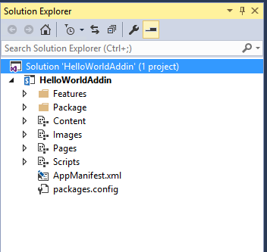
Visual Studio: SharePoint Add-In
SharePoint Hosted Add-In
Add-in Web Feature
Used to add items to Add-in Web
Modules
Content module
Images module
Pages module
Scripts module
AppManifest.xml
Contains metadata for Add-In deployment
Notes:
Each SharePoint Add-In project created as a SharePoint-hosted Add-In contains a single feature which is used to add elements to Add-In web such as lists, pages and JavaScript files. Note that each SharePoint Add-In project should contain exactly one feature and the scope of this feature should be equal to web which means the features activates at the site within the Add-In web.
A new SharePoint Add-In project is created with the following modules:
Content module: Used to add CSS files and images to Add-in web
Images module: Used to add image for Add-In icon
Pages module: used to add pages (.aspx and .htm) to Add-in web
Scripts module: used to add JavaScript source files to Add-in web
Everything SharePoint Add-In required a manifest files which is named AppManifest.xml. The Visual Studio project template for SharePoint Application automatically adds this file and provides default values for all the required settings.

Slide 24
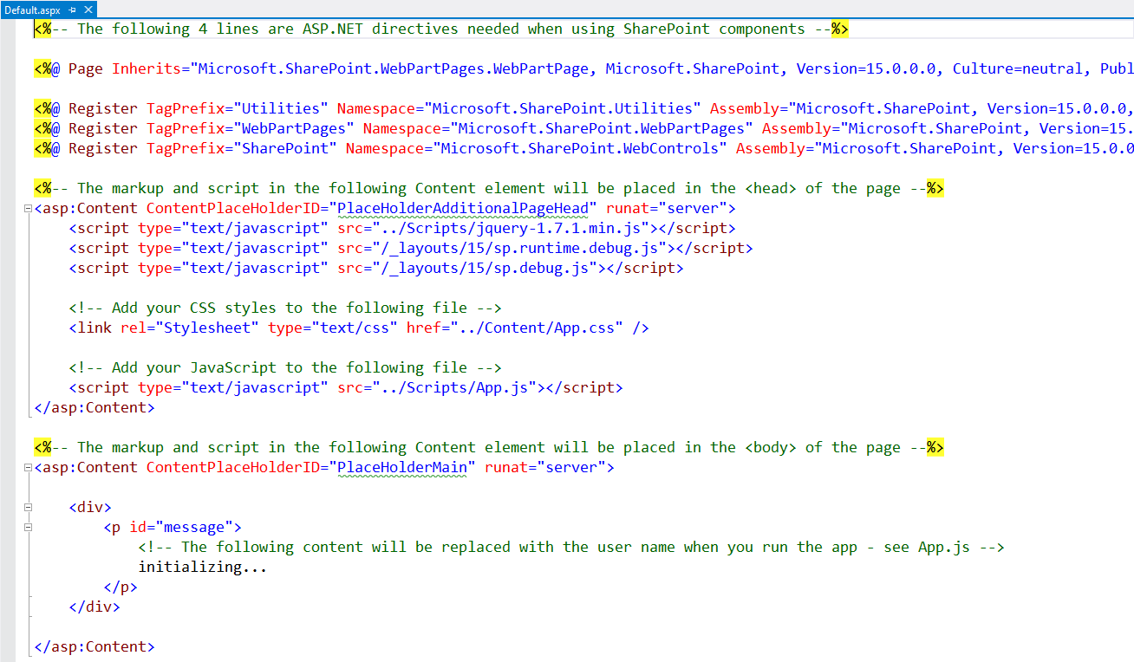
Visual Studio: SharePoint Hosted
Modifying Default.aspx
Notes:
When Visual Studio creates a new Visual Studio project for a SharePoint Add-In, it automatically adds a start page named Default.aspx. Inside Default.aspx it adds two Content controls for the placeholders PlaceHolderAdditionalPageHead and PlaceHolderMain.
Inside PlaceHolderAdditionalPageHead , Visual studio automatically adds links to App.css and App.js. PlaceHolderMain contains some sample markup for your Add-In. There is where you add the HTML to create the user interface for your start page.

Slide 25
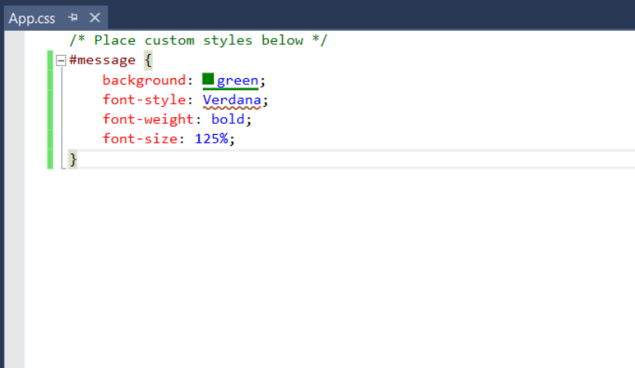
Visual Studio: SharePoint Hosted
Modifying App.css
Notes:
While Visual Studio create the App.css file for you, this file is initially empty. This is where you add the CSS to style the HTML elements to your pages in your project.
Note that Visual Studio 2012 used to have a visual CSS designer available by right clicking and choosing Build Style. This has been removed since Visual Studio 2013 and is no longer available. See: https://connect.microsoft.com/VisualStudio/feedback/details/805848/css-editor-context-menu-missing-build-style-option

Slide 26
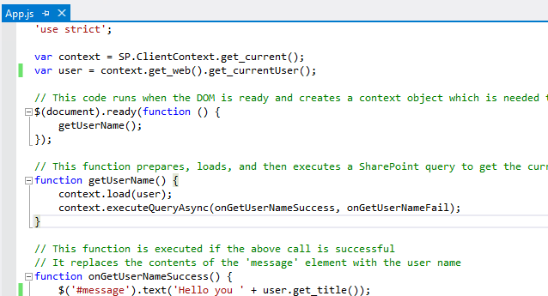
Visual Studio: SharePoint Hosted
Modifying App.js
Notes:
App.js contains a basic working example by default where it communicates back to the Add-in Web in SharePoint using JSOM to fetch the current users’ full name and displays it. It can nicely be used to modify and extend with your own desired functionality.
Notice the ‘use strict’; statement here. It tells the JavaScript compiler to handle a more strict code check when compiling the JavaScript. For example it doesn’t allow a var test to be set to a string at first and later to be assigned a number. This ensures potential issues with code due to the flexibility of JavaScript will be detected during compilation already.
The reason why it’s defined as ‘use strict’;, so basically a string, is so that older JavaScript compilers not supporting the strict mode will simply read it as a normal string and basically will ignore it. Newer JavaScript compilers will recognize this keyword and will apply the strict compilation.
When placing the ‘use strict’; at the top of a JS file, as shown here, it applied to all JavaScript in this file. You can also apply it inside a function so to only have it apply to code inside that function. This can particularly be useful when having to deal with a large formerly written JavaScript library that doesn’t meet the strict requirements, but you do want newly added code to be compiled with the strict rules.

Slide 27
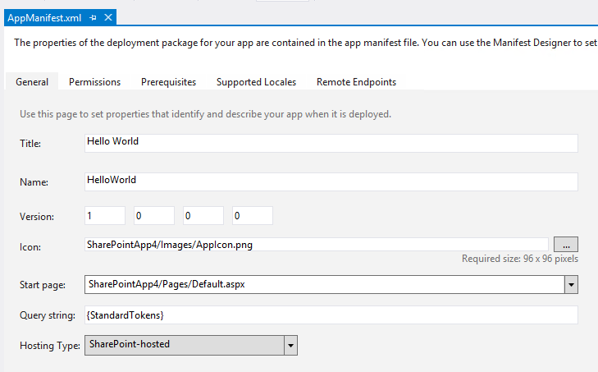
Visual Studio: SharePoint Add-In
AppManifest
Friendly name of the Add-In shown in i.e. site contents, app catalog
Internal name used for the AppWeb subsite naming
Version of the Add-In. Increment manually to update an Add-In
Icon shown after installing the App
Page to load when entering the Add-In
Tokens to be added to the query string of the Add-In start page
Defines how the Add-In will be hosted
Notes:
The Application manifest file named AppManifest.xml is very important because it contains the Application’s high-level metadata that is read by SharePoint during Add-In installation. The version of AppManifest.xml shown in this example is very simples and represents the initial settings of the Add-In after you create a new project.
AppManifest.xml defines high-level Add-In attributes
Visual Studio 2013 and 2015 provide visual designer
You can open AppManifest.xml in code view to see/edit XML directly
Note that a SharePoint Application has a Name property which is used to construct the Url to the Add-In’s start page. It also has an identifying GUID which served as the ProductID. There is also a Version number and an SharePointMinVersion attribute with a value of 16.0.0.0 that indicates the SharePoint Application required SharePoint 2016 or later.
The AppManifest must specify an Application principal using an AppPrincipal element. The Internal setting is supplied by Visual Studio by default and can be used for SharePoint-hosted Add-Ins.

Slide 28
SharePoint Add-In Manifest
Token | Resolves to | StartPage | Custom Action | App Part | Remarks
~appWebUrl | The URL of the add-in web of an app for SharePoint. | Yes | Yes | Yes | This token should be used only outside an add-in web. Within the app web itself, use ~site for the URL of the app web.
~controlTemplates | The URL of the ControlTemplates virtual folder for the current website. | No | No | No
~hostUrl | The URL of the host web. | No | No | Yes
~hostLogoUrl | The URL of the logo of the host web. | No | No | No
~layouts | The URL of the Layouts virtual folder for the current website. | No | No | No
~remoteAppUrl | The URL of a remote web application in an add-in for SharePoint. | Yes | Yes, in the host web, but No in the add-in web. | Yes | If you are not using Visual Studio and Microsoft Office Developer Tools to develop your Add-in for SharePoint, you cannot use ~remoteAppUrl in the StartPage URL. However, when you are using Visual Studio and the tools, you can use this token for any provider-hosted add-in and it is resolved when Visual Studio packages the add-in. In this usage, it is really more of a Visual Studio token than a SharePoint token. It can be used outside the add-in manifest , even when you are not using Microsoft Office Developer Tools for Visual Studio.
~site | The URL of the current website. | No | No | Yes
~sitecollection | The URL of the parent site collection of the current website. | No | No | Yes
Tokens (1/3)
Notes:
This slide is a reference slide of the kind of tokens you may use in the Add-in Manifest for the deployment URL to have Visual Studio replace them with actual values on deployment time. You don’t need to discuss all of these one by one. Just point out that it can be made more dynamic than a bunch of static settings.
For more information, see: http://msdn.microsoft.com/en-us/library/office/jj163816.aspx

Slide 29
SharePoint Add-In Manifest
Token | Resolves to | StartPage | Custom Action | App Part | Remarks
{AppContextToken} | The OAuth context token for the add-in. | No | No | No
{AppWebUrl} | The URL of the add-in web in an add-in for SharePoint. | Yes | Yes | Yes | This token should be used only outside an add-in web. Within the add-in web itself, use {Site} for the URL of the app web.
{ClientTag} | The client cache control number (client tag) for the current website. | Yes | Yes | Yes
{HostLogoUrl} | The logo for the host web of an add-in for SharePoint. | Yes | Yes | Yes
{HostTitle} | The title of the host web of an add-in for SharePoint. | Yes | Yes | Yes
{HostUrl} | The URL of the host web of an add-in for SharePoint. | Yes | Yes | Yes
{ItemId} | The ID of an item in a list or library (an integer). | No | Yes | No
{ItemUrl} | The URL of the item being acted upon. | No | Yes | No
Tokens (2/3)
Notes:
This slide is a reference slide of the kind of tokens you may use in the AppManifest to have Visual Studio replace them with actual values on deployment time. You don’t need to discuss all of these one by one. Just point out that it can be made more dynamic than a bunch of static settings.
For more information, see: http://msdn.microsoft.com/en-us/library/office/jj163816.aspx

Slide 30
SharePoint Add-In Manifest
{Language} | The current language/culture of the host web of an add-in for SharePoint. | Yes | Yes | Yes
{ListId} | The ID of the current list (a GUID). | No | Yes | No
{ProductNumber} | The full build version number of the SharePoint farm. | Yes | Yes | Yes | An example value is "15.0.4433.1011".
{RecurrenceId} | The recurrence index of a recurring event. | No | Yes | No | This token is not supported for use in the context menus of list items.
{RemoteAppUrl} | The URL of a remote web application in an add-in for SharePoint. | Yes | Yes | Yes
{Site} | The URL of the current website. | No | Yes | Yes
{SiteCollection} | The URL of the parent site of the current website. | No | Yes | Yes
{SiteUrl} | The URL of the current website. | No | Yes | No
{Source} | The HTTP Request URL. | No | Yes | No
{StandardTokens} | See Remarks. | Yes | Yes | Yes | This combines five other tokens. It initially resolves to SPHostUrl={HostUrl}&SPAppWebUrl={AppWebUrl}&SPLanguage={Language}&SPClientTag={ClientTag}&SPProductNumber={ProductNumber}. Then each of these tokens resolves. If there is no app web, the portion &SPAppWebUrl={AppWebUrl} is not present.
Tokens (3/3)
Notes:
This slide is a reference slide of the kind of tokens you may use in the AppManifest to have Visual Studio replace them with actual values on deployment time. You don’t need to discuss all of these one by one. Just point out that it can be made more dynamic than a bunch of static settings.
For more information, see: http://msdn.microsoft.com/en-us/library/office/jj163816.aspx

Slide 31
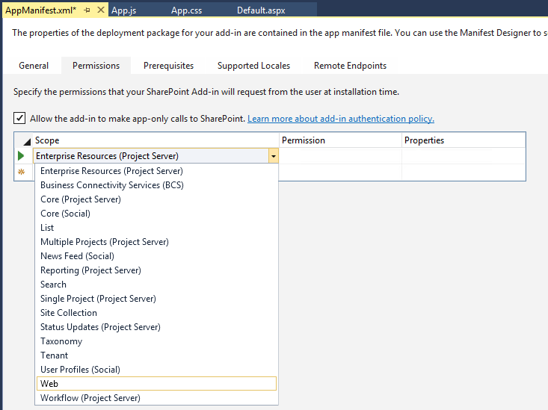
Visual Studio: Add-In Manifest
Defines if this Add-In should verify the user rights next to the Add-In rights
Defines the type of rights that this Add-In needs
Defines the level of rights this Add-In needs
Notes:
The Application manifest file named AppManifest.xml is very important because it contains the Application’s high-level metadata that is read by SharePoint during Add-In installation. The version of AppManifest.xml shown in this example is very simple and represents the initial settings of the Add-In after you create a new project.
AppManifest.xml defines high-level Add-In attributes
Visual Studio 2013/2015 provide visual designer
You can open AppManifest.xml in code view to see/edit XML directly
Note that a SharePoint Application has a Name property which is used to construct the Url to the Add-In’s start page. It also has an identifying GUID which served as the ProductID. There is also a Version number and an SharePointMinVersion attribute with a value of 16.0.0.0 that indicates the SharePoint Application required SharePoint 2016 or later.
The AppManifest must specify an Application principal using an AppPrincipal element. The Internal setting is supplied by Visual Studio by default and can be used for SharePoint-hosted Add-Ins.

Slide 32
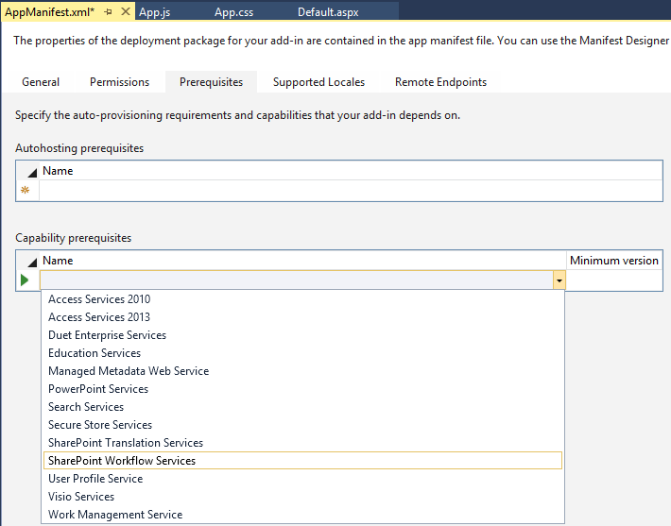
Visual Studio: Add-In Manifest
Autohosted no longer exists, this this section is now obsolete
Allows defining prerequisites for a SharePoint 2016 farm in order for this App to be installable

Slide 33
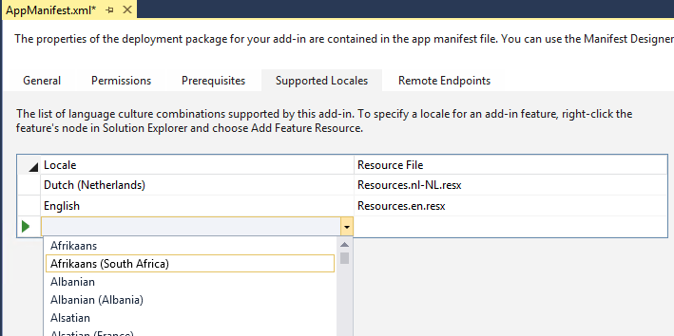
Visual Studio: Add-In Manifest
Allows supported languages for your Add-In to be defined. This will automatically add a resource file to the project

Slide 34
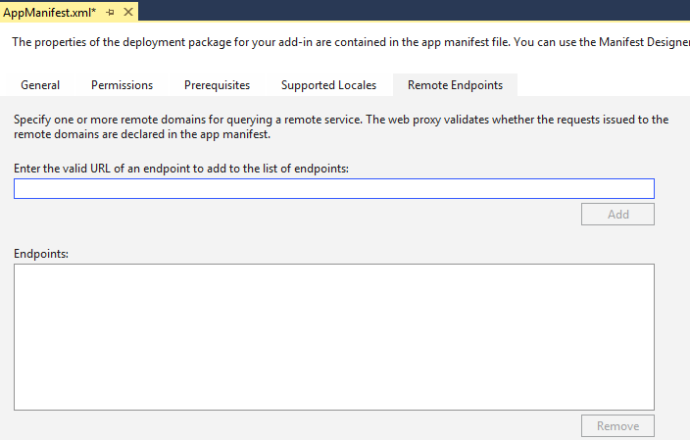
Visual Studio: Add-In Manifest
Defines which services can be called through the WebProxy. Will be discussed in detail later.

Slide 35
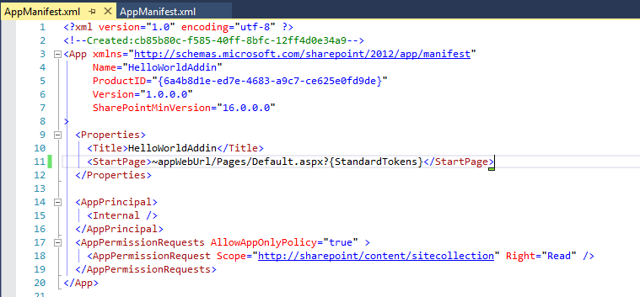
Visual Studio: Add-In Manifest

Slide 36
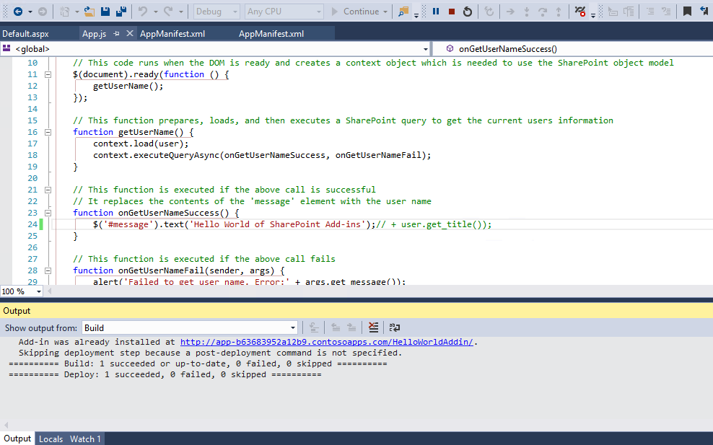
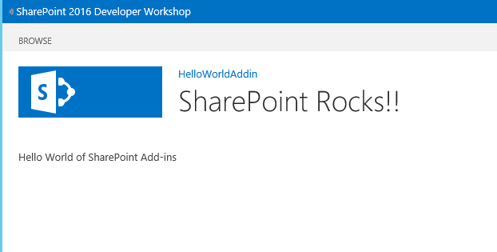
Visual Studio: Test an Add-In Using F5
Notes:
So how do you test and debug a SharePoint Add-In project? It’s just like every other type of project in Visual Studio. You press the {F5} key to begin the process of packaging and deploying the Add-In for testing.
Note that is might take a long time such as 20 or 30 seconds to deploy your Add-In the first time you press the {F5} key. However, it is much faster after that. When you press the {F5} for the second or third time, it often deploys in about 5-10 seconds.

Slide 37
Visual Studio: Test an Add-In Using F5
Things to keep in mind
Don’t use System Account
You cannot install Add-Ins to SharePoint using the system account or farm admin
Deploy to a SharePoint Developer Site
When activating in clientcontext, side loading applications is only allowed by default on Developer Sites (DEV#0)
Side loading can be enabled manually on other sites
Enable-SPFeature e374875e-06b6-11e0-b0fa-57f5dfd72085 -url <SITE COLLECTION URL>
Not recommended
Notes:
Use a Developer Site for deploying and testing your Add-Ins from client machine or enable the Developer feature
Visual studio 2013 will complain about a missing feature Developer if you attempt to deploy an Application within clientcontext (not server)to a SharePoint site that is not created with the “Developer Site” template since it will be missing required lists and content types. So if you for example try to deploy your Add-In (Using Visual Studio F5) to a team site or a publishing portal you will get the following error in Visual studio’s Error List:
Error occurred in deployment step ‘Install App for SharePoint’: Sideloading of Apps is not enabled on this site.
In order to overcome this issue you need to enable the Developer feature on your Site collection where you want to deploy and test your Add-Ins using Visual Studio. Since this feature is hidden you will not see it in the list of the site collection feature, so you will need to enable it using PowerShell:
Enable-SPFeature e374875e-06b6-11e0-b0fa-57f5dfd72085 -url <SITE COLLECTION URL>
Don’t use Farm admin (System Account) to deploy and test Add-Ins
SharePoint will not allow you to install or uninstall Add-Ins using the farm account (System Account). If you try to deploy your Add-In using Visual Studio F5 you will get one of the following errors if you do it using System Account:
Error occurred in deployment step ‘Install App for SharePoint’: The System Account cannot perform this action.
Cannot perform this action
Sorry, something went wrong Please refresh the page and try again.
To avoid this issue you need to log in to SharePoint with a different account (not the farm admin) and\or running Visual studio with a different account other than the farm admin. Since in SharePoint 2016 we have removed the Sign in a different user menu option, you can get to it through the following URL:
/_layouts/closeConnection.aspx?loginasanotheruser=true
For more info check this out: http://blogs.msdn.com/b/how24/archive/2013/06/14/prepare-your-sharepoint-2013-farm-for-App-development-and-debugging.aspx

Slide 38
Visual Studio: What happens when pressing F5
Tokens in AppManifest.xml and other project files get updated
Application package gets created with inside:
AppManifest.xml
Inner .wsp file for the Add-In Web
Other files associated with the feature (if any)
Add-In package gets uploaded to SharePoint using CSOM
“hosts” file gets updated with the Add-In web URL
Internet Explorer launches to home page of Add-In Web
JavaScript debugger attaches to Internet Explorer
If you don’t want the Visual Studio JavaScript debugger to attach (i.e. you want to use the Developer Toolbar), start with CTRL + F5 instead
Notes:
The only difference between start an Add-In with the CTRL + {F5} keyboard and combination and starting an Add-In by pressing the {F5} key has to do with whether or not you want Visual Studio to attach its JavaScript debugger to the Internet Explorer during your test/debug session. When you press the {F5} key without the CTRL key, Visual Studio attaches its JavaScript debugger which allows you to single step through your JavaScript code inside Visual Studio.
Note that you can only attach one JavaScript debugger at a time. Therefore, if you would like to single-step through your JavaScript code using the Internet Explorer Developer Tools, you should start the project using CTRL {F5} instead of {F5}.

Slide 39
Add-In Logging
What we can use it for
Write logging data to SharePoint using CSOM
Helps in monitoring the Add-In in a central location
Added logs may take several minutes to show up in the Add-In
Notes:
Monitor Apps for SharePoint Server 2013:
https://docs.microsoft.com/en-us/SharePoint/administration/monitor-apps-for-sharepoint
SPUtility.LogCustomRemoteAppError():
https://docs.microsoft.com/en-us/previous-versions/office/sharepoint-server/jj835471(v=office.15)

Slide 40
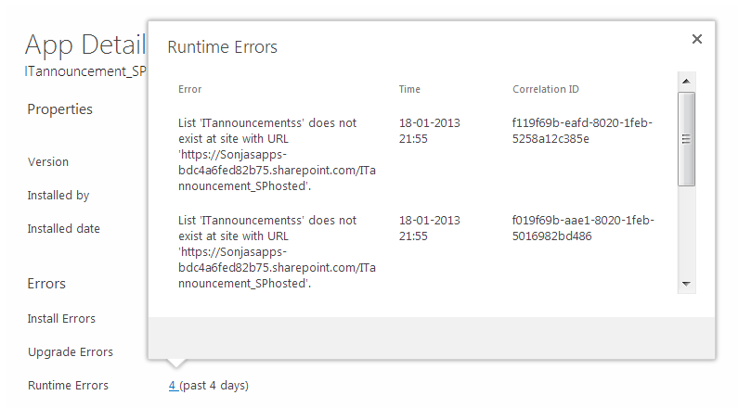
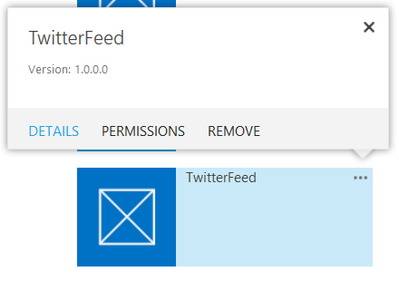
How to view the logged errors
Go to an Add-In in Site Contents
Click on its Ellipses
Click on Detail
Click on Runtime Errors
Notes:
Follow the steps shown on the slide to view the logs of a specific Add-In. Keep in mind that SharePoint does not log anything itself to this log. All the logging that will be shown here has to be done by the developer by using a specific API, which will be discussed in the next slides.

Slide 41
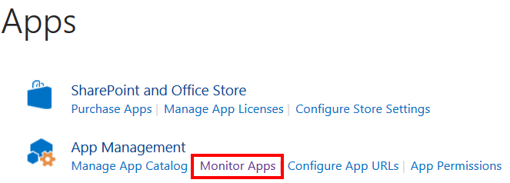
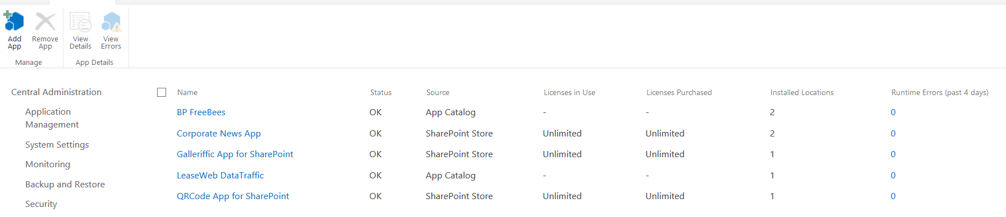
How to centrally monitor Add-Ins
Go to Central Administration
Go to Apps
Go to Monitor Apps
Add Apps to monitor
View the aggregated results of all instances
Notes:
If you want to centrally monitor the Add-Ins, Central Administration allows you to do so. Again, note that Runtime Errors is only populated if the Add-In developer has implemented the proper API to log these types of errors. If the developer has not and this shows 0, it by no means is an indication that the Add-In is running smoothly.

Slide 42
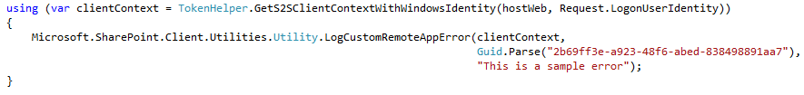
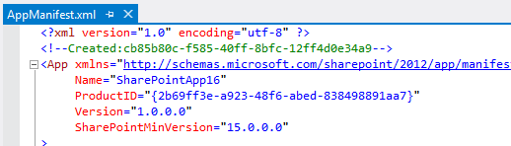
How to use it through CSOM
Add the Microsoft.SharePoint.Client and Microsoft.SharePoint.Client.Runtime DLLs to your project
Call LogCustomRemoteAppError
Provide a valid ClientContext
GUID is the product GUID, must be stored in Add-In since it cannot be retrieved and must match AppManifest
Notes:
If you want to make use of the logging, in CSOM, you can call the Utility method shown on this slide. The GUID you pass in must match the ProductID GUID in your app.manifest so SharePoint knows to which Add-In to add the log entry. The Product ID is an unique identifier for your Add-In, regardless where or how often it is installed, so it will always remain the same.
As you can see it’s easy to utilize the extra logging capability in SharePoint. It is therefore recommended to make use of it in your Add-In code.

Slide 43
Knowledge Check
What are the tools you can use to develop SharePoint Add-Ins?
You can use Visual Studio 2013 or later to develop SharePoint Add-Ins
What are the two hosting types of SharePoint Add-Ins?
SharePoint-hosted
Provider-hosted
Which hosting model only allows execution of client logic within the client browser? Where do its artefacts reside?
SharePoint-hosted Add-Ins
Its artefacts reside in the App Web in SharePoint

Slide 44
Lesson Summary
Reasons to start using Add-Ins
Introducing the new SharePoint Add-In Model
Add-In Model Architecture Overview
Add-In Hosting Models

Slide 45
Questions?

Slide 46
Lab: SharePoint hosted Add-Ins
SharePoint Add-Ins can be centered on SharePoint artifacts, cloud resources, or both. In this lab, you will create several SharePoint-hosted Add-Ins that primarily use SharePoint artifacts. At the end of the lab, you will have a good understanding of the techniques for creating SharePoint-hosted Add-Ins.
Time estimation: 75 minutes
Notes:
Lab content can be found under “Lab - SharePoint Hosted Addins”

